Slide 1
Working with scRNA-seq data from multiple samples
Imre Västrik
imre.vastrik@fimm.fi / imre.vastrik@gmail.com
+358 400 159 355

Slide 2
What is the most boring part of scRNA-seq data analysis?

Slide 3
What is the most boring part of scRNA-seq data analysis?
source("https://raw.githubusercontent.com/romikasaini/scRNAseq_pipeline/main/funcs.R")
<WAIT />
y <- SeuratSctype(
datadir, save = T,plot = T, top20 = T,
precise = T, res = 0.8, N_dims = 10, UMAP_dims = 15
)
<WAIT MORE />

Slide 4
Pipelining & sharing analysis results
Automation
Standardisation
Reproducibility
Saving resources
https://towardsdatascience.com/scientific-data-analysis-pipelines-and-reproducibility-75ff9df5b4c5
Notes:
Automation – less manual work, less “active waiting”. Especially important when we have multiple samples to analyse
Standardisation – doing things in the same manner
Reproducibility – getting same output from the same same input on different occasions
Saving resources – time, compute cycles, storge space, electricity, money

Slide 5
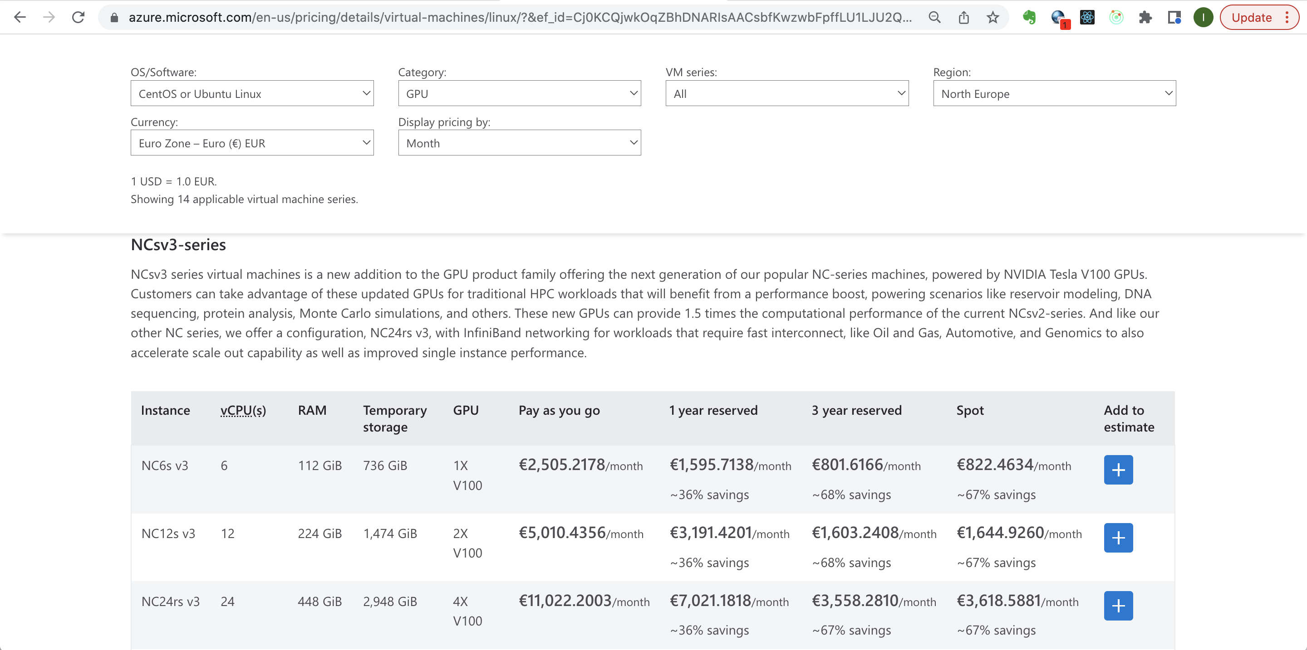
Notes:
https://azure.microsoft.com/en-us/pricing/details/virtual-machines/linux/?&ef_id=Cj0KCQjwkOqZBhDNARIsAACsbfKwzwbFpffLU1LJU2QwKVIGbZmaDF1ImPhfKiSG7ZM4_FeAKmQU3ggaAjfREALw_wcB:G:s&OCID=AIDcmmftanc7uz_SEM_Cj0KCQjwkOqZBhDNARIsAACsbfKwzwbFpffLU1LJU2QwKVIGbZmaDF1ImPhfKiSG7ZM4_FeAKmQU3ggaAjfREALw_wcB:G:s&gclid=Cj0KCQjwkOqZBhDNARIsAACsbfKwzwbFpffLU1LJU2QwKVIGbZmaDF1ImPhfKiSG7ZM4_FeAKmQU3ggaAjfREALw_wcB#pricing

Slide 6
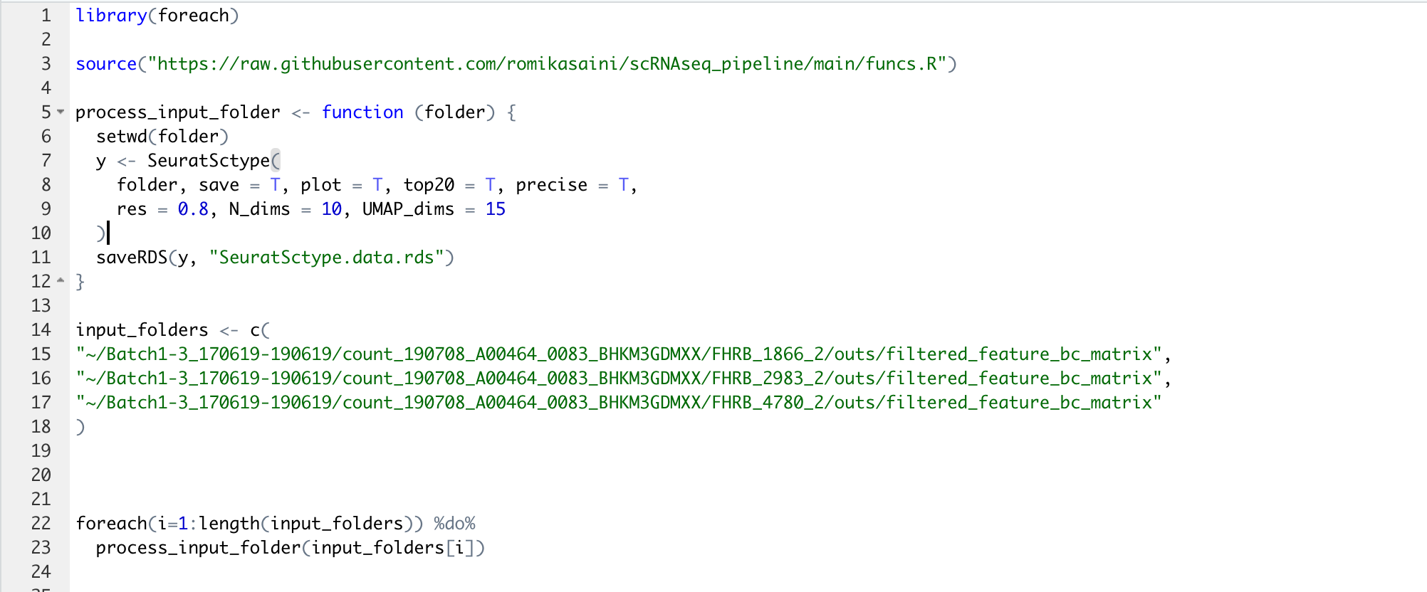
Really simple pipeline – example
Notes:
library(foreach)
source("https://raw.githubusercontent.com/romikasaini/scRNAseq_pipeline/main/funcs.R")
process_input_folder <- function (folder) {
setwd(folder)
y <- SeuratSctype(
folder, save = T, plot = T, top20 = T, precise = T,
res = 0.8, N_dims = 10, UMAP_dims = 15
)
saveRDS(y, "SeuratSctype.data.rds")
}
input_folders <- c(
"~/Batch1-3_170619-190619/count_190708_A00464_0083_BHKM3GDMXX/FHRB_1866_2/outs/filtered_feature_bc_matrix",
"~/Batch1-3_170619-190619/count_190708_A00464_0083_BHKM3GDMXX/FHRB_2983_2/outs/filtered_feature_bc_matrix",
"~/Batch1-3_170619-190619/count_190708_A00464_0083_BHKM3GDMXX/FHRB_4780_2/outs/filtered_feature_bc_matrix"
)
foreach(i=1:length(input_folders)) %do%
process_input_folder(input_folders[i])

Slide 7
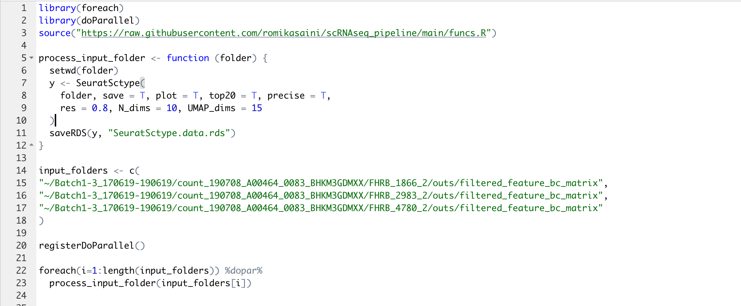
Really simple pipeline – parallellised
Notes:
Obviously these are somewhat toy examples geared towards things you can readily do on your own computer.
Hopefully you don’t have to do everything on your own computer. Many research institutions have their own beefy servers or compute clusters or have a deal with an compute infrastructure provider for using their equipment for this kind of heavy lifting. There the way you launch things are most likely very different. Often there’s some sort of a batch queue to witch you’d have to submit your jobs and in this case this code would look somewhat different. You may have to think about where the input data is located. Some of it may look intimidating, but on the up side you may get your analysis done more quickly compared to doing it on your own machine.
Now, presumably the reason why we are doing the analyses is not just the fun of doing it but the output. When we do the analysis interactively the output may appear straight “on screen”. This won’t happen when batch processing. Instead, it needs to be persisted somewhere. In the example I gave you the output was 3 files – two plots that SeuratSctype generates, one for QC and the other for viewing the clusters, and the rds file encapsulating all the data the this analysis produces – which are saved in the input directory. This is good in the sense that the output is pretty tightly linked with the input.
And this may indeed be enough.
But… what if you don’t have permissions to write into that directory because as a precautionary measure against accidental data deletion you can only have read only access.
Or the opposite – you have everything on *your *disk and then want or need to share it it with your colleagues.
Also, since we are now looking across multiple samples, chances are that we want to compare these samples somehow, for example how similar or different they are. Sure, we have all the data encapsulated in the stored SeuratSctype objects which we can “resuscitate” quickly compared to creating them from the scratch, but in order to do so the person doing it has the be an R programmer.
Hence, it may be worth to make the data that we think is going to be used often more readily available. And by this I don’t mean just putting the relevant bits into yet another file of its own but into a database.
At FIMM we’ve been using something called TheDB which I originally developed for handling the data of our functional precision medicine program. Whereas this was time before single cell sequencing, we weren’t exactly suffering from the shortage of data.

Slide 9
demo
https://tbd.fimm.fi/dbview5#/App/633d2be4097aa5b850680142

Slide 10
TheDB in a nutshell
Browser based point-and-click interface to (m)any kind(s) of data
People/subjects/donors/patients, personal details, family relationships
Clinical lab results, diagnoses & treatments
Samples – tissue type, date, storage location, requested & performed analyses
Omics data – genotypes, somatic mutations, RNA & protein expression levels, drug sensitivities
Questionnaires & answers / Patient-Reported Outcome Measures (PROMs)
Images, videos and other files
+ integrated data model editor
Notes:
From the user's perspective TheDB is a browser based point-and-click interface to many kinds of data. For example, the installation at FIMM contains records on:
* People, some of whom are patients
* their clinical lab results, diagnoses & treatments
* samples they've donated
* omics data
* as well as questionnaires and answers,
TheDB also handles images, videos and other files.

Slide 11
TheDB in a nutshell
Browser based point-and-click interface to (m)any kind(s) of data
“Plain English” view of the data
Easy querying and fast responses
Versatile access control, easy access rights management
A tool for collecting your data in structured and interoperable manner
Configurable views / reports
Logging & audit trail
Bulk data download, web API for programmatic access, integrated RStudio
Notes:
Thanks to the integrated "meta data" it provides a plain english view of the data. You don’t have to guess what the value in the gender field mean.
Every user can access only the data items to which the user has been granted access directly or via a role and only to a specified extent. By extent I mean that for a user a data item can be either completely invisible, or discoverable, i.e. appear in aggregate results, if there are enough of them, or visible or even editable.
Everything is logged and there is a record for every addition, change, deletion or even just accessing the data.

Slide 12
Interested in TheDB?
Contact me
+358 400 159 355 (WhatsApp, Signal)
imre.vastrik@fimm.fi imre.vastrik@gmail.com

